Slide 1

Web Application Development
COMP-229

Slide 2
AUTHENTICATION

Slide 3
Auth with JSON Web Tokens
To restrict and protect access to user API endpoints according to the skeleton features, the backend will need to incorporate authentication and authorization mechanisms.
There are a number of options when it comes to implementing user auth for web applications.
The most common and time-tested option is the use of sessions to store user state on both the client and server-side.
But a newer approach is the use of JSON Web Token (JWT) as a stateless authentication mechanism that does not require storing user state on the server side.

Slide 4
Both approaches have strengths for relevant real-world use cases.
However, for the purpose of keeping the code simple in and because it pairs well with the MERN stack and our example applications, we will use JWT for auth implementation.

Slide 5
How JWT works
Before diving into the implementation of authentication with JWT in the MERN stack, we will look at how this mechanism generally works across a client-server application, as outlined in the following diagram:

Slide 6
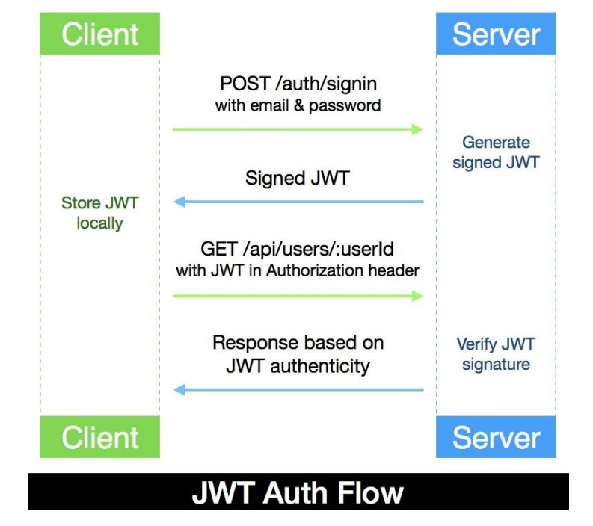

Slide 7
Initially, when a user signs in using their credentials, the server-side generates a JWT signed with a secret key and a unique user detail.
Then, this token is returned to the requesting client to be saved locally either in localStorage, sessionStorage or a cookie in the browser, essentially handing over the responsibility for maintaining user state to the client-side.

Slide 8
For HTTP requests that are made following a successful sign-in, especially requests for API endpoints that are protected and have restricted access, the client-side has to attach this token to the request.
More specifically, the JSON Web Token must be included in the request Authorization header as a Bearer:
Authorization: Bearer <JSON Web Token>

Slide 9
When the server receives a request for a protected API endpoint, it checks the Authorization header of the request for a valid JWT, then verifies the signature to identify the sender and ensures the request data was not corrupted.
If the token is valid, the requesting client is given access to the associated operation or resource; otherwise, an authorization error is returned.

Slide 10
In the skeleton application, when a user signs in with their email and password, the backend will generate a signed JWT with the user's ID and with a secret key that's available only on the server.
This token will then be required for verification when a user tries to view any user profiles, update their account details, or delete their user account.
Implementing the user model to store and validate user data, then integrating it with APIs to perform CRUD operations based on auth with JWT, will produce a functioning standalone backend. We will look at how to achieve this in the MERN stack and setup.

Slide 11
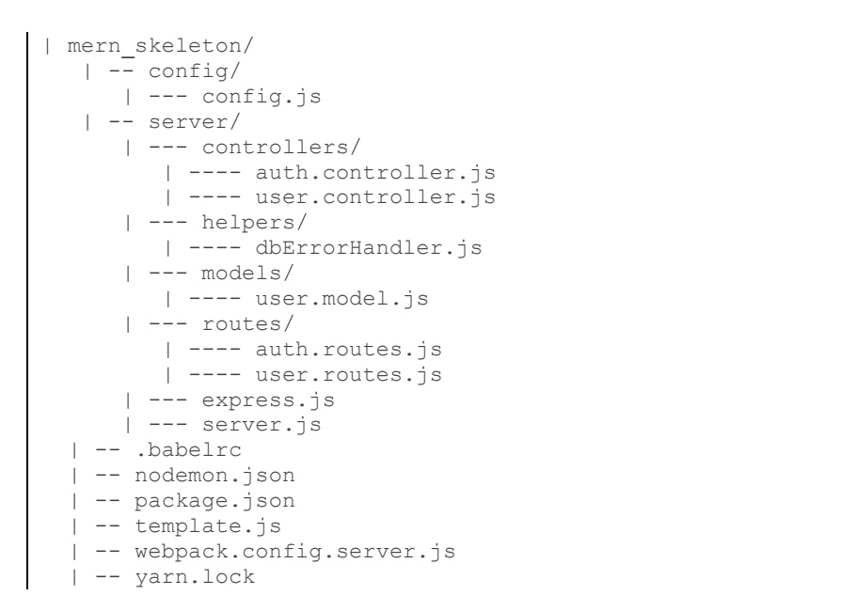
Folder and file structure

Slide 12
Handling the password string as a virtual field
The password string that's provided by the user is not stored directly in the user
document. Instead, it is handled as a virtual field.

Slide 13
Handling the password string as a virtual field
mern-skeleton/server/models/user.model.js:
import mongoose from 'mongoose'
//const mongoose = require('mongoose');
const UserSchema = new mongoose.Schema({
name: {
type: String,
trim: true,
required: 'Name is required'
},
email: {
type: String,
trim: true,
unique: 'Email already exists',
match: [/.+\@.+\..+/, 'Please fill a valid email address'],
required: 'Email is required'
},
created: {
type: Date,
default: Date.now
},
updated: {
type: Date,
default: Date.now
},
hashed_password: {
type: String,
required: 'Password is required'
},
salt: String
});
UserSchema.virtual('password')
.set(function(password) {
this._password = password;
this.salt = this.makeSalt();
this.hashed_password = this.encryptPassword(password)
//this.hashed_password = password;
})
.get(function() {
return this._password;
});
UserSchema.path('hashed_password').validate(function(v) {
if (this._password && this._password.length < 6) {
this.invalidate('password', 'Password must be at least 6 characters.');
}
if (this.isNew && !this._password) {
this.invalidate('password', 'Password is required');
}
}, null);
//module.exports = mongoose.model('User', UserSchema);
export default mongoose.model('User', UserSchema);

Slide 14
Handling the password string as a virtual field
When the password value is received on user creation or update, it is encrypted into a new hashed value and set to the hashed_password field, along with the unique salt value in the salt field.

Slide 15
Encryption and authentication
The encryption logic and salt generation logic, which are used to generate the hashed_password and salt values representing the password value, are defined as UserSchema methods.

Slide 16
Updated user.model.js
mern-skeleton/server/models/user.model.js:
import mongoose from 'mongoose'
//const mongoose = require('mongoose');
const UserSchema = new mongoose.Schema({
name: {
type: String,
trim: true,
required: 'Name is required'
},
email: {
type: String,
trim: true,
unique: 'Email already exists',
match: [/.+\@.+\..+/, 'Please fill a valid email address'],
required: 'Email is required'
},
created: {
type: Date,
default: Date.now
},
updated: {
type: Date,
default: Date.now
},
hashed_password: {
type: String,
required: 'Password is required'
},
salt: String
});
UserSchema.virtual('password')
.set(function(password) {
this._password = password;
this.salt = this.makeSalt();
this.hashed_password = this.encryptPassword(password)
this.hashed_password = password;
})
.get(function() {
return this._password;
});
UserSchema.path('hashed_password').validate(function(v) {
if (this._password && this._password.length < 6) {
this.invalidate('password', 'Password must be at least 6 characters.');
}
if (this.isNew && !this._password) {
this.invalidate('password', 'Password is required');
}
}, null);
UserSchema.methods = {
authenticate: function(plainText) {
return this.encryptPassword(plainText) === this.hashed_password
},
encryptPassword: function(password) {
if (!password) return ''
try {
return crypto
.createHmac('sha1', this.salt)
.update(password)
.digest('hex')
} catch (err) {
return ''
}
},
makeSalt: function() {
return Math.round((new Date().valueOf() * Math.random())) + ''
}
}
//module.exports = mongoose.model('User', UserSchema);
export default mongoose.model('User', UserSchema);

Slide 17
The UserSchema methods can be used to provide the following functionality:
authenticate: This method is called to verify sign-in attempts by matching the user-provided password text with the hashed_password stored in the database for a specific user.
encryptPassword: This method is used to generate an encrypted hash from the plain-text password and a unique salt value using the crypto module from Node.
makeSalt: This method generates a unique and random salt value using the current timestamp at execution and Math.random().

Slide 18
The crypto module provides a range of cryptographic functionality, including some standard cryptographic hashing algorithms.
In our code, we use the SHA1 hashing algorithm and createHmac from crypto to generate the cryptographic HMAC hash from the password text and salt pair.Hashing algorithms generate the same hash for the same input value.
But to ensure two users don't end up with the same hashed password if they happen to use the same password text, we pair each password with a unique salt value before generating the hashed password for each user.

Slide 19
This will also make it difficult to guess the hashing algorithm being used because the same user input is seemingly generating different hashes.
These UserSchema methods are used to encrypt the user-provided password string into a hashed_password with a randomly generated salt value.
The hashed_password and the salt are stored in the user document when the user details are saved to the database on a create or update.
Both the hashed_password and salt values are required in order to match and authenticate a password string provided during user sign-in using the authenticate method.

Slide 20
We should also ensure the user selects a strong password string to begin with, which can done by adding custom validation to the passport field.

Slide 21
Integrating user auth and protected routes
To restrict access to user operations such as user profile view, user update, and user delete, we will first implement sign-in authentication with JWT, then use it to protect and authorize the read, update, and delete routes.
The auth-related API endpoints for sign-in and sign-out will be declared in server/routes/auth.routes.js and then mounted on the Express app in server/express.js.

Slide 22
Updated server/express.js
import express from 'express'
import bodyParser from 'body-parser'
import cookieParser from 'cookie-parser'
import compress from 'compression'
import cors from 'cors'
import helmet from 'helmet'
import Template from './../template.js'
import userRoutes from './routes/user.routes.js'
import authRoutes from './routes/auth.routes'
//import devBundle from './devBundle'
import path from 'path'
const app = express()
const CURRENT_WORKING_DIR = process.cwd()
//devBundle.compile(app)
//...
app.get('/', (req, res) => {
res.status(200).send(Template())
})
//...
app.use('/dist', express.static(path.join(CURRENT_WORKING_DIR, 'dist')))
app.use(express.json());
app.use(express.urlencoded({ extended: true }));
app.use('/', userRoutes)
app.use('/', authRoutes)
app.use(bodyParser.json())
app.use(bodyParser.urlencoded({ extended: true }))
app.use(cookieParser())
app.use(compress())
app.use(helmet())
app.use(cors())
export default app

Slide 23
This will make the routes we define in auth.routes.js accessible from the client-side.

Slide 24
Auth routes
The two auth APIs are defined in the auth.routes.js file using express.Router() to declare the route paths with the relevant HTTP methods.
They're also assigned the corresponding controller functions, which should be called when requests are received for these routes.
The auth routes are as follows:
'/auth/signin': POST request to authenticate the user with their email and password
'/auth/signout': GET request to clear the cookie containing a JWT that was set on the response object after sign-in
The resulting mern-skeleton/server/routes/auth.routes.js file will be as
follows:

Slide 25
mern-skeleton/server/routes/auth.routes.js
import express from 'express'
import authCtrl from '../controllers/auth.controller'
const router = express.Router()
router.route('/auth/signin').post(authCtrl.signin)
router.route('/auth/signout').get(authCtrl.signout)
export default router

Slide 26
A POST request to the signin route and a GET request to the signout route will invoke the corresponding controller functions defined in the auth.controller.js file next.

Slide 27
Auth controller
The auth controller functions in server/controllers/auth.controller.js will not only handle requests to the signin and signout routes, but also provide JWT and express-jwt functionality to enable authentication and authorization for protected user API endpoints.
The mern-skeleton/server/controllers/auth.controller.js file will have the following structure:

Slide 28
mern-skeleton/server/controllers/auth.controller.js
import User from '../models/user.model'
import jwt from 'jsonwebtoken'
import expressJwt from 'express-jwt'
import config from './../../config/config'
const signin = (req, res) => {
}
const signout = (req, res) => {
}
const requireSignin = ‘’
const hasAuthorization = (req, res) => {
}
export default { signin, signout, requireSignin, hasAuthorization }

Slide 29
The four controller functions are elaborated on as follows to show how the backend implements user auth using JSON Web Tokens.
We'll start with the signin controller function in the next section.
The API endpoint to sign-in a user is declared in the following route.
mern-skeleton/server/routes/auth.routes.js:

Slide 30
Sign-in
mern-skeleton/server/routes/auth.routes.js:
import express from 'express'
import authCtrl from '../controllers/auth.controller'
const router = express.Router()
router.route('/auth/signin').post(authCtrl.signin)
router.route('/auth/signout').get(authCtrl.signout)
export default router

Slide 31
When the Express app gets a POST request at '/auth/signin', it executes the signin controller function.

Slide 32
mern-skeleton/server/controllers/auth.controller.js:
import User from '../models/user.model'
import jwt from 'jsonwebtoken'
import expressJwt from 'express-jwt'
import config from './../../config/config'
const signin = async (req, res) => {
try {
let user = await User.findOne({ "email": req.body.email })
if (!user)
return res.status('401').json({ error: "User not found" })
if (!user.authenticate(req.body.password)) {
return res.status('401').send({ error: "Email and password don't match." })
}
const token = jwt.sign({ _id: user._id }, config.jwtSecret)
res.cookie('t', token, { expire: new Date() + 9999 })
return res.json({
token,
user: {
_id: user._id,
name: user.name,
email: user.email
}
})
} catch (err) {
return res.status('401').json({ error: "Could not sign in" })
}
}
const signout = (req, res) => {
}
const requireSignin = ‘’
const hasAuthorization = (req, res) => {
}
export default { signin, signout, requireSignin, hasAuthorization }

Slide 33
The POST request object receives the email and password in req.body. This email is used to retrieve a matching user from the database.
Then, the password authentication method defined in UserSchema is used to verify the password that’s received in req.body from the client. If the password is successfully verified, the JWT module is used to generate a signed JWT using a secret key and the user's _id value.
Install the jsonwebtoken module to make it available to this controller in the import by running
yarn add jsonwebtoken from the command line i.e terminal.
Then, the signed JWT is returned to the authenticated client, along with the user's details.

Slide 34
Optionally, we can also set the token to a cookie in the response object so that it is available to the client-side if cookies are the chosen form of JWT storage.
On the client-side, this token must be attached as an Authorization header when requesting protected routes from the server. To sign-out a user, the client-side can simply delete this token depending on how it is being stored.
In the next section, we will learn how to use a signout API endpoint to clear the cookie containing the token.

Slide 35
Signout
The API endpoint to sign-out a user is declared in the following route.
mern-skeleton/server/routes/auth.routes.js:
import express from 'express'
import authCtrl from '../controllers/auth.controller'
const router = express.Router()
router.route('/auth/signin') .post(authCtrl.signin)
router.route('/auth/signout').get(authCtrl.signout)
export default router

Slide 36
When the Express app gets a GET request at '/auth/signout', it executes the signout controller function.

Slide 37
mern-skeleton/server/controllers/auth.controller.js:
//Add the highlighted line of script
import User from '../models/user.model'
import jwt from 'jsonwebtoken'
import expressJwt from 'express-jwt'
import config from './../../config/config'
const signin = async (req, res) => {
try {
let user = await User.findOne({ "email": req.body.email })
if (!user)
return res.status('401').json({ error: "User not found" })
if (!user.authenticate(req.body.password)) {
return res.status('401').send({ error: "Email and password don't match." })
}
const token = jwt.sign({ _id: user._id }, config.jwtSecret)
res.cookie('t', token, { expire: new Date() + 9999 })
return res.json({
token,
user: {
_id: user._id,
name: user.name,
email: user.email
}
})
} catch (err) {
return res.status('401').json({ error: "Could not sign in" })
}
}
const signout = (req, res) => {
res.clearCookie("t")
return res.status('200').json({
message: "signed out"
})
}
const requireSignin = ‘’
const hasAuthorization = (req, res) => {
}
export default { signin, signout, requireSignin, hasAuthorization }

Slide 38
The signout function clears the response cookie containing the signed JWT.
This is an optional endpoint and not really necessary for auth purposes if cookies are not used at all in the frontend.
With JWT, user state storage is the client’s responsibility, and there are multiple options for client-side storage besides cookies.
On signout, the client needs to delete the token on the client-side to establish that the user is no longer authenticated.

Slide 39
On the server-side, we can use and verify the token that's generated at sign-in to protect routes that should not be accessed without valid authentication.
next we will learn how to implement these protected routes using JWT.

Slide 40
Protecting routes with express-jwt
To protect access to the read, update, and delete routes, the server will need to check that the requesting client is actually an authenticated and authorized user.
To check whether the requesting user is signed in and has a valid JWT when a protected route is accessed, we will use the express-jwt module.
The express-jwt module is a piece of middleware that validates JSON Web Tokens.
Run yarn add express-jwt from the command line i.e terminal to install express-jwt.

Slide 41
Protecting user routes
We will define two auth controller methods called requireSignin and hasAuthorization, both of which will be added to the user route declarations that need to be protected with authentication and authorization.
The read, update, and delete routes in user.routes.js need to be updated as follows.

Slide 42
Updated mern-skeleton/server/routes/user.routes.js:
Updated user.routes.js
import express from 'express'
import userCtrl from '../controllers/user.controller.js'
import authCtrl from '../controllers/auth.controller'
const router = express.Router()
router.route('/api/users')
.get(userCtrl.list)
.post(userCtrl.create)
router.route('/api/users/:userId')
.get(authCtrl.requireSignin, userCtrl.read)
.put(authCtrl.requireSignin, authCtrl.hasAuthorization,
userCtrl.update)
.delete(authCtrl.requireSignin, authCtrl.hasAuthorization,
userCtrl.remove)
router.param('userId', userCtrl.userByID)
router.route('/api/users/:userId').get(userCtrl.read)
router.route('/api/users/:userId').put(userCtrl.update)
router.route('/api/users/:userId').delete(userCtrl.remove)
export default router

Slide 43
The route to read a user's information only needs authentication verification, whereas the update and delete routes should check for both authentication and authorization before these CRUD operations are executed.
We will look into the implementation of the requireSignin method, which checks authentication, and the hasAuthorization method, which check authorization, in the next section.

Slide 44
Requiring sign-in
The requireSignin method in auth.controller.js uses express-jwt to verify that the incoming request has a valid JWT in the Authorization header.
If the token is valid, it appends the verified user's ID in an 'auth' key to the request object; otherwise, it throws an authentication error.

Slide 45
Updated mern-skeleton/server/controllers/auth.controller.js:
import User from '../models/user.model'
import jwt from 'jsonwebtoken'
import expressJwt from 'express-jwt'
import config from './../../config/config'
const signin = async (req, res) => {
try {
let user = await User.findOne({ "email": req.body.email })
if (!user)
return res.status('401').json({ error: "User not found" })
if (!user.authenticate(req.body.password)) {
return res.status('401').send({ error: "Email and password don't match." })
}
const token = jwt.sign({ _id: user._id }, config.jwtSecret)
res.cookie('t', token, { expire: new Date() + 9999 })
return res.json({
token,
user: {
_id: user._id,
name: user.name,
email: user.email
}
})
} catch (err) {
return res.status('401').json({ error: "Could not sign in" })
}
}
const signout = (req, res) => {
res.clearCookie("t")
return res.status('200').json({
message: "signed out"
})
}
const requireSignin = expressJwt({
secret: config.jwtSecret,
userProperty: 'auth'
})
const hasAuthorization = (req, res) => {
}
export default { signin, signout, requireSignin, hasAuthorization }

Slide 46
We can add requireSignin to any route that should be protected against unauthenticated access.

Slide 47
Authorizing signed in users
For some of the protected routes, such as update and delete, on top of checking for authentication we also want to make sure the requesting user is only updating or deleting their own user information.
To achieve this, the hasAuthorization function defined in auth.controller.js will check whether the authenticated user is the same as the user being updated or deleted before the corresponding CRUD controller function is allowed to proceed.

Slide 48
Updated mern-skeleton/server/controllers/auth.controller.js:
import User from '../models/user.model'
import jwt from 'jsonwebtoken'
import expressJwt from 'express-jwt'
import config from './../../config/config'
const signin = async (req, res) => {
try {
let user = await User.findOne({ "email": req.body.email })
if (!user)
return res.status('401').json({ error: "User not found" })
if (!user.authenticate(req.body.password)) {
return res.status('401').send({ error: "Email and password don't match." })
}
const token = jwt.sign({ _id: user._id }, config.jwtSecret)
res.cookie('t', token, { expire: new Date() + 9999 })
return res.json({
token,
user: {
_id: user._id,
name: user.name,
email: user.email
}
})
} catch (err) {
return res.status('401').json({ error: "Could not sign in" })
}
}
const signout = (req, res) => {
res.clearCookie("t")
return res.status('200').json({
message: "signed out"
})
}
const requireSignin = expressJwt({
secret: config.jwtSecret,
userProperty: 'auth'
})
const hasAuthorization = (req, res, next) => {
const authorized = req.profile && req.auth
&& req.profile._id == req.auth._id
if (!(authorized)) {
return res.status('403').json({
error: "User is not authorized"
})
}
next()
}
export default { signin, signout, requireSignin, hasAuthorization }

Slide 49
The req.auth object is populated by express-jwt in requireSignin after authentication verification, while req.profile is populated by the userByID function in user.controller.js.
We will add the hasAuthorization function to routes that require both authentication and authorization.

Slide 50
Auth error handling for express-jwt
To handle auth-related errors thrown by express-jwt when it tries to validate JWT tokens in incoming requests, we need to add the following error-catching code to the Express app configuration in mern-skeleton/server/express.js, near the end of the code, after the routes are mounted and before the app is exported:

Slide 51
mern-skeleton/server/express.js
import express from 'express'
import bodyParser from 'body-parser'
import cookieParser from 'cookie-parser'
import compress from 'compression'
import cors from 'cors'
import helmet from 'helmet'
import Template from './../template.js'
import userRoutes from './routes/user.routes.js'
import authRoutes from './routes/auth.routes'
//import devBundle from './devBundle'
import path from 'path'
const app = express()
const CURRENT_WORKING_DIR = process.cwd()
//devBundle.compile(app)
//...
app.get('/', (req, res) => {
res.status(200).send(Template())
})
//...
app.use('/dist', express.static(path.join(CURRENT_WORKING_DIR, 'dist')))
app.use(express.json());
app.use(express.urlencoded({ extended: true }));
app.use('/', userRoutes)
app.use('/', authRoutes)
app.use(bodyParser.json())
app.use(bodyParser.urlencoded({ extended: true }))
app.use(cookieParser())
app.use(compress())
app.use(helmet())
app.use(cors())
app.use((err, req, res, next) => {
if (err.name === 'UnauthorizedError') {
res.status(401).json({"error" : err.name + ": " + err.message})
}else if (err) {
res.status(400).json({"error" : err.name + ": " + err.message})
console.log(err)
}
})
export default app

Slide 52
Updated express.js
mport express from 'express'
import bodyParser from 'body-parser'
import cookieParser from 'cookie-parser'
import compress from 'compression'
import cors from 'cors'
import helmet from 'helmet'
import Template from './../template.js'
import userRoutes from './routes/user.routes.js'
import authRoutes from './routes/auth.routes.js'
//import devBundle from './devBundle'
import path from 'path'
const app = express()
const CURRENT_WORKING_DIR = process.cwd()
//devBundle.compile(app)
//...
app.get('/', (req, res) => {
res.status(200).send(Template())
})
//...
app.use('/dist', express.static(path.join(CURRENT_WORKING_DIR, 'dist')))
app.use(express.json());
app.use(express.urlencoded({ extended: true }));
app.use('/', userRoutes)
app.use('/', authRoutes)
app.use(bodyParser.json())
app.use(bodyParser.urlencoded({ extended: true }))
app.use(cookieParser())
app.use(compress())
app.use(helmet())
app.use(cors())
app.use((err, req, res, next) => {
if (err.name === 'UnauthorizedError') {
res.status(401).json({"error" : err.name + ": " + err.message})
}else if (err) {
res.status(400).json({"error" : err.name + ": " + err.message})
console.log(err)
}
})
export default app

Slide 53
Updated user.routes.js
import express from 'express'
import userCtrl from '../controllers/user.controller.js'
import authCtrl from '../controllers/auth.controller.js'
const router = express.Router()
router.route('/api/users')
.get(userCtrl.list)
.post(userCtrl.create)
router.route('/api/users/:userId')
.get(authCtrl.requireSignin, userCtrl.read)
.put(authCtrl.requireSignin, authCtrl.hasAuthorization,
userCtrl.update)
.delete(authCtrl.requireSignin, authCtrl.hasAuthorization,
userCtrl.remove)
router.param('userId', userCtrl.userByID)
router.route('/api/users/:userId').get(userCtrl.read)
router.route('/api/users/:userId').put(userCtrl.update)
router.route('/api/users/:userId').delete(userCtrl.remove)
export default router

Slide 54
Updated auth.routes.js
import express from 'express'
import authCtrl from '../controllers/auth.controller.js'
const router = express.Router()
router.route('/auth/signin') .post(authCtrl.signin)
//router.route('/auth/signin').post(authCtrl.signin)
router.route('/auth/signout').get(authCtrl.signout)
router.route('/auth/signout')
.get(authCtrl.signout)
export default router

Slide 55
Updated auth.controller.js
import User from '../models/user.model.js'
import jwt from 'jsonwebtoken'
import expressJwt from 'express-jwt'
import config from './../../config/config.js'
const signin = async (req, res) => {
try {
let user = await User.findOne({ "email": req.body.email })
if (!user)
return res.status('401').json({ error: "User not found" })
if (!user.authenticate(req.body.password)) {
return res.status('401').send({ error: "Email and password don't match." })
}
const token = jwt.sign({ _id: user._id }, config.jwtSecret)
res.cookie('t', token, { expire: new Date() + 9999 })
return res.json({
token,
user: {
_id: user._id,
name: user.name,
email: user.email
}
})
} catch (err) {
return res.status('401').json({ error: "Could not sign in" })
}
}
const signout = (req, res) => {
res.clearCookie("t")
return res.status('200').json({
message: "signed out"
})
}
const requireSignin = expressJwt({
secret: config.jwtSecret,
userProperty: 'auth'
})
const hasAuthorization = (req, res, next) => {
const authorized = req.profile && req.auth
&& req.profile._id == req.auth._id
if (!(authorized)) {
return res.status('403').json({
error: "User is not authorized"
})
}
next()
}
export default { signin, signout, requireSignin, hasAuthorization }

Slide 56
Updated auth.controller.js
import User from '../models/user.model.js'
import jwt from 'jsonwebtoken'
//import expressJwt from 'express-jwt'
import { expressjwt } from "express-jwt";
import config from './../../config/config.js'
const signin = async (req, res) => {
try {
let user = await User.findOne({ "email": req.body.email })
if (!user)
return res.status('401').json({ error: "User not found" })
if (!user.authenticate(req.body.password)) {
return res.status('401').send({ error: "Email and password don't match." })
}
const token = jwt.sign({ _id: user._id }, config.jwtSecret)
res.cookie('t', token, { expire: new Date() + 9999 })
return res.json({
token,
user: {
_id: user._id,
name: user.name,
email: user.email
}
})
} catch (err) {
return res.status('401').json({ error: "Could not sign in" })
}
}
const signout = (req, res) => {
res.clearCookie("t")
return res.status('200').json({
message: "signed out"
})
}
const requireSignin = expressjwt({
secret: config.jwtSecret,
algorithms: ["HS256"],
userProperty: 'auth'
})
const hasAuthorization = (req, res, next) => {
const authorized = req.profile && req.auth
&& req.profile._id == req.auth._id
if (!(authorized)) {
return res.status('403').json({
error: "User is not authorized"
})
}
next()
}
export default { signin, signout, requireSignin, hasAuthorization }

Slide 57
express-jwt throws an error named UnauthorizedError when a token cannot be validated for some reason.
We catch this error here to return a 401 status back to the requesting client.
We also add a response to be sent if other server-side errors are generated and caught here.
With user auth implemented for protecting routes, we have covered all the desired features of a working backend for our skeleton MERN application.
In the next section, we will look at how we can check whether this standalone backend is functioning as desired without implementing a frontend.

Slide 58
Install crypto in the server side (cd server) as follows:
Yarn add crypto
Import it in the
server/models/user.model.js
Remove or mark as comment the following line of script
//this.hashed_password = password;

Slide 59
Updated server/models/user.model.js
//const mongoose = require('mongoose');
import mongoose from 'mongoose'
import crypto from 'crypto'
const UserSchema = new mongoose.Schema({
name: {
type: String,
trim: true,
required: 'Name is required'
},
email: {
type: String,
trim: true,
unique: 'Email already exists',
match: [/.+\@.+\..+/, 'Please fill a valid email address'],
required: 'Email is required'
},
created: {
type: Date,
default: Date.now
},
updated: {
type: Date,
default: Date.now
},
hashed_password: {
type: String,
required: 'Password is required'
},
salt: String
});
UserSchema.virtual('password')
.set(function(password) {
this._password = password;
this.salt = this.makeSalt();
this.hashed_password = this.encryptPassword(password);
//this.hashed_password = password;
})
.get(function() {
return this._password;
});
UserSchema.path('hashed_password').validate(function(v) {
if (this._password && this._password.length < 6) {
this.invalidate('password', 'Password must be at least 6 characters.');
}
if (this.isNew && !this._password) {
this.invalidate('password', 'Password is required');
}
}, null);
UserSchema.methods = {
authenticate: function(plainText) {
return this.encryptPassword(plainText) === this.hashed_password
},
encryptPassword: function(password) {
if (!password) return ''
try {
return crypto
.createHmac('sha1', this.salt)
.update(password)
.digest('hex')
} catch (err) {
return ''
}
},
makeSalt: function() {
return Math.round((new Date().valueOf() * Math.random())) + ''
}
}
//module.exports = mongoose.model('User', UserSchema);
export default mongoose.model('User', UserSchema);

Slide 60
Switch to the client side.
Run the application - yarn dev

